Slide 1

Job Market Analysis and Recommendation System
Name- Debasis Panda
Project-8
Batch-VI

Slide 2
Case Flow
Objective and EDA
Analyze the correlation between job title keywords and offered salaries
Identify emerging job categories based on posting frequency
Predict high-demand job roles by analyzing job posting patterns over time
Compare average hourly rates across different countries
Create a job recommendation engine based on current job postings
Track changes in job market dynamics over months
Investigate trends in the remote work landscape
Job Demand on Stream Lit

Slide 3
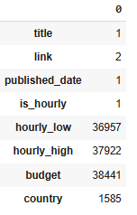
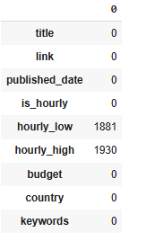
Objective and EDA
The primary objective of this project is to analyze job market trends and build a recommendation system for job seekers based on real-time data. The system will help in identifying high-demand job roles, salary trends, and emerging job categories, and will provide personalized job recommendations.
The null values of budget column were treated based on the combination a composite Vader score of ‘title’ and ‘country’ fields
Null values of ‘country ‘ attributes were filled based on mode values
Post treatment below is the revised null values
EDA
Data Set is having 244828 rows × 7 columns
It has got following null values

Slide 4
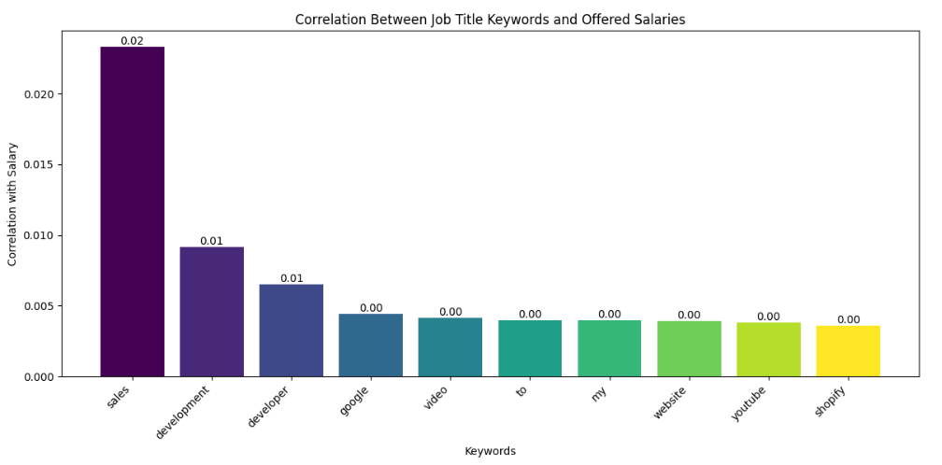
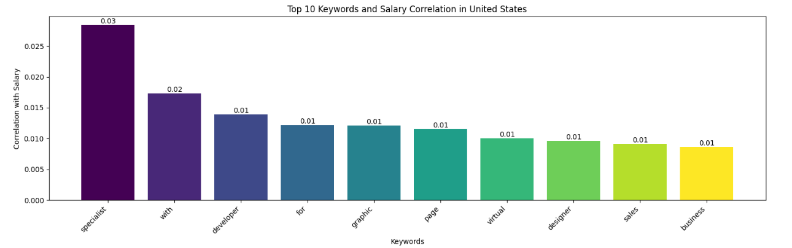
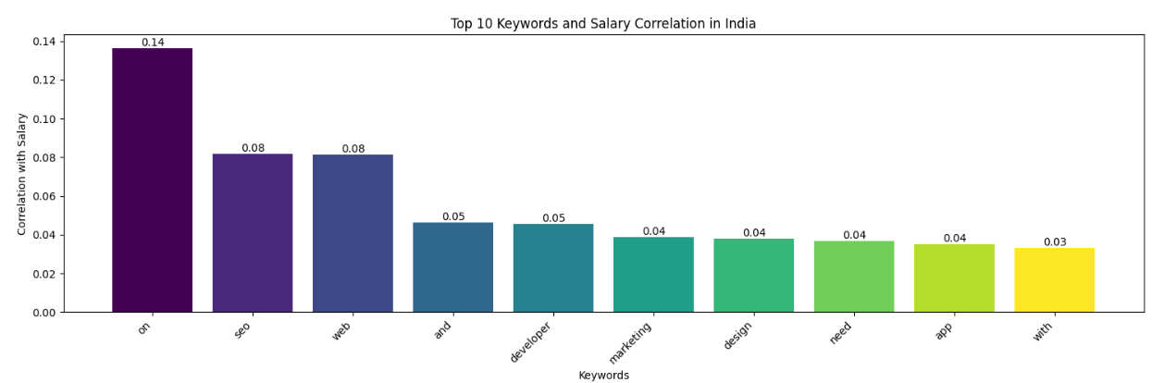
Analyze the Correlation between job title keywords and offered Salaries
Figure-2
Figure-1
Sales followed by development and developer are having top three maximum correlation with Salary(Fig-1)
For United States Specialists are having maximum correlation with Salary(Fig-2)
For India SEO and Web are having equal correlation with Salary(Fig-3)
Figure-3

Slide 5
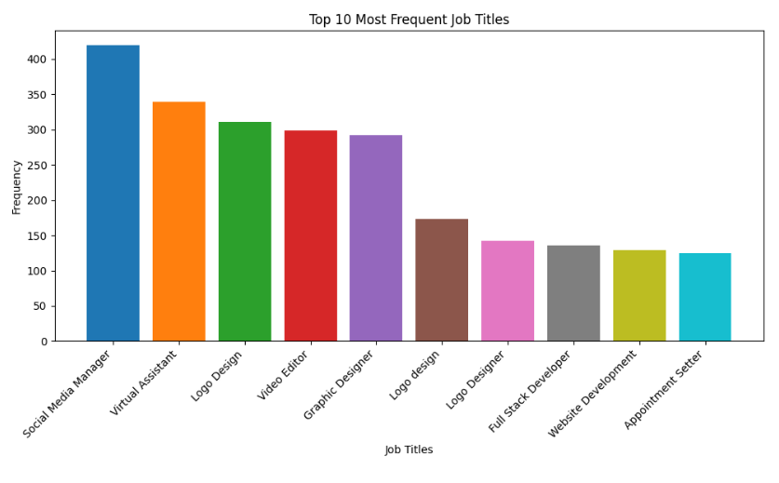
Identify Emerging job Categories Based on Posting Frequency
Social Media Manager and Virtual Assistant followed by Logo Design were among the top three jobs based on the posting frequency

Slide 6
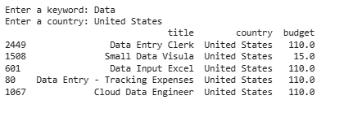

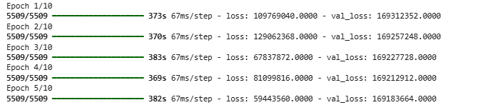
Predict high-demand job roles by Analyzing job Posting Patterns over time
Collaborative Filtering followed by Random Forest ,Naïve Bayes, Support Vector Classifier approaches were utilized to build and find accuracy for predicting jobs
The best model was saved in a pickle file and with the Vectoizer
Also inbuilt ‘xlm-roberta-base’ method was used from Transformer
Based on input text and country, users were shown the job fields
Deep Learning LSTM model was utilized to build, compile, predict and save the model

Slide 7
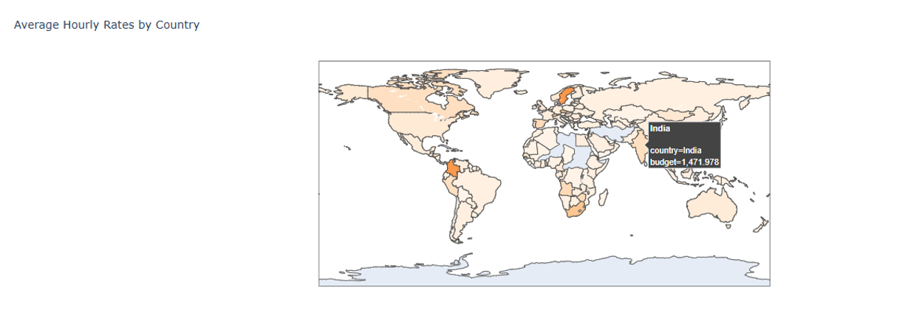
Compare average hourly rates across different countries
Plotly method was used to create an interactive map and show the hourly rates across countries

Slide 8
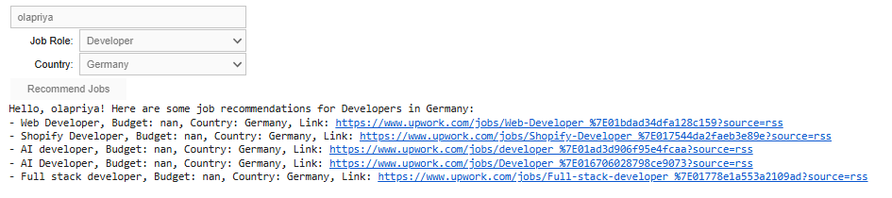
Create a job Recommendation Engine based on current job postings
Collaborative Based Filtering , cosine Similarity and Beautiful soup methods were used to search for jobs based on the Job Role and Country mentioned by user
For Developer job in Germany, list of similar jobs were recommended for the user

Slide 9
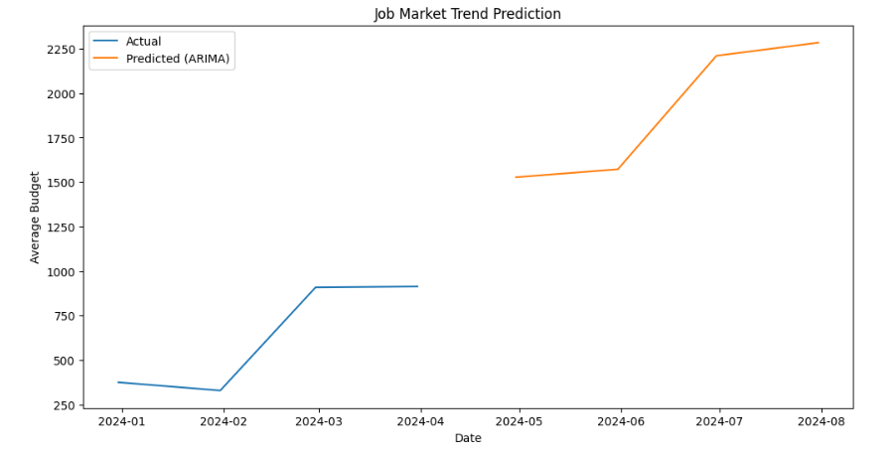
Track changes in job market dynamics over months
ARIMA method was used to track changes in Job Market
The budget seems an increasing trend from feb to March

Slide 10
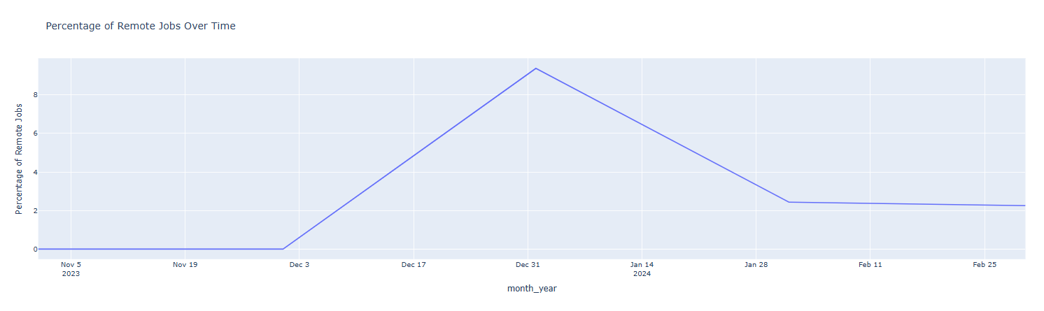
Investigate Trends in the Remote Work Landscape
Percentage of job postings have shown towards Feb 25 compared to Dec 19
Significant increase in remote job posting during the period 19

Slide 11
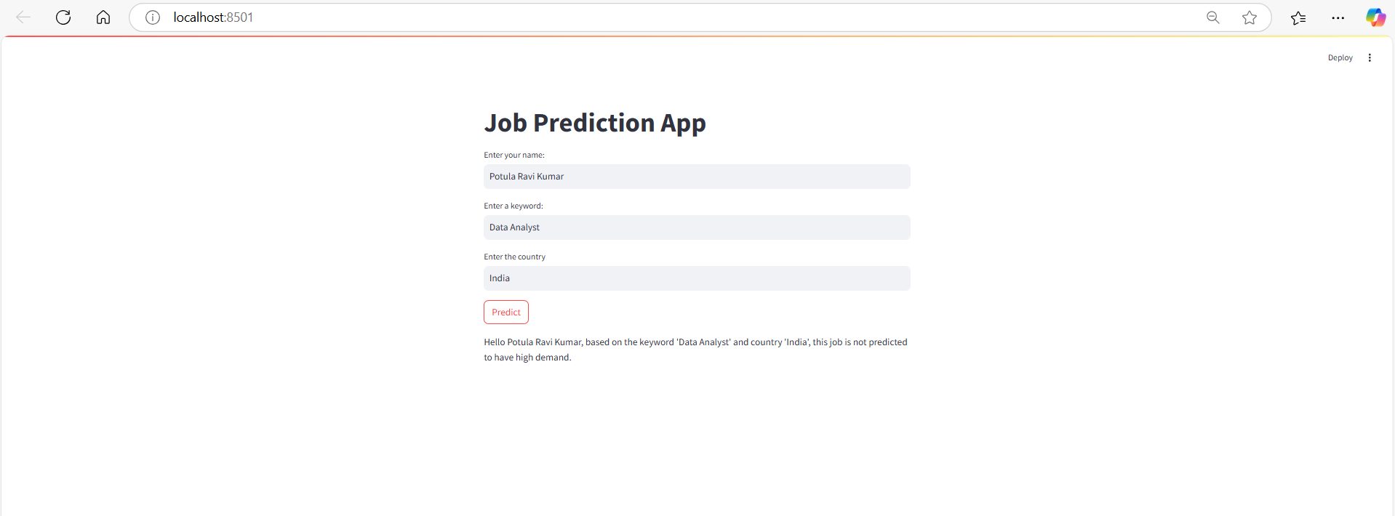
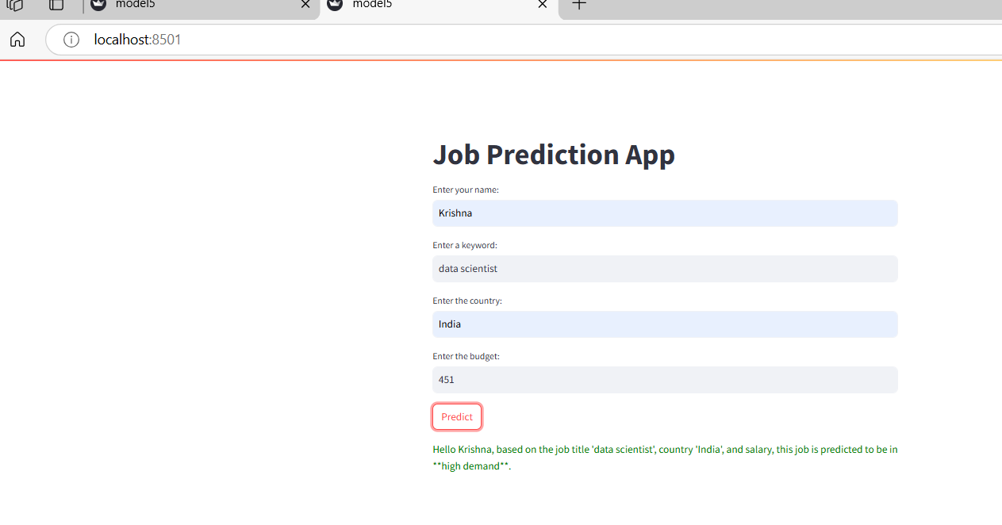
Job Demand on Stream Lit
ML based .pkl file was unbundled
A probabilistic approach was taken to predict the on/off demand of jobs on the .py file and display on Stremlit
Data Scientist job with higher and Data Analyst job with low demand based on the probabilistic approach was shown for India
THANK YOU

